Slide 1












Slide 2











BESPIN GLOBAL SERVICE PORTFOLIO
Cloud Consultancy
Cloud Professional Services
Cloud Managed Services
Cloud Migration
Cloud FinOps
DevOps & App Modernization
Helping some of the biggest brands in their Microsoft Cloud Journeys
ADNOC Distribution
ADNOC Global Trading

Slide 3


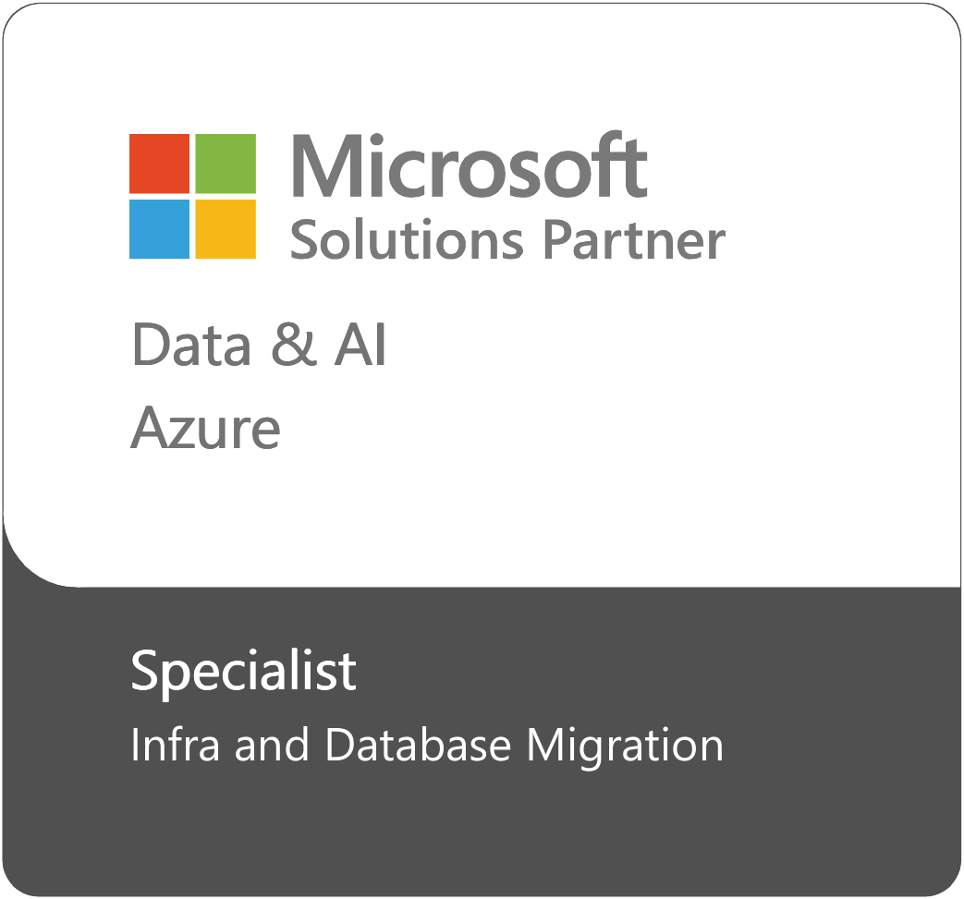

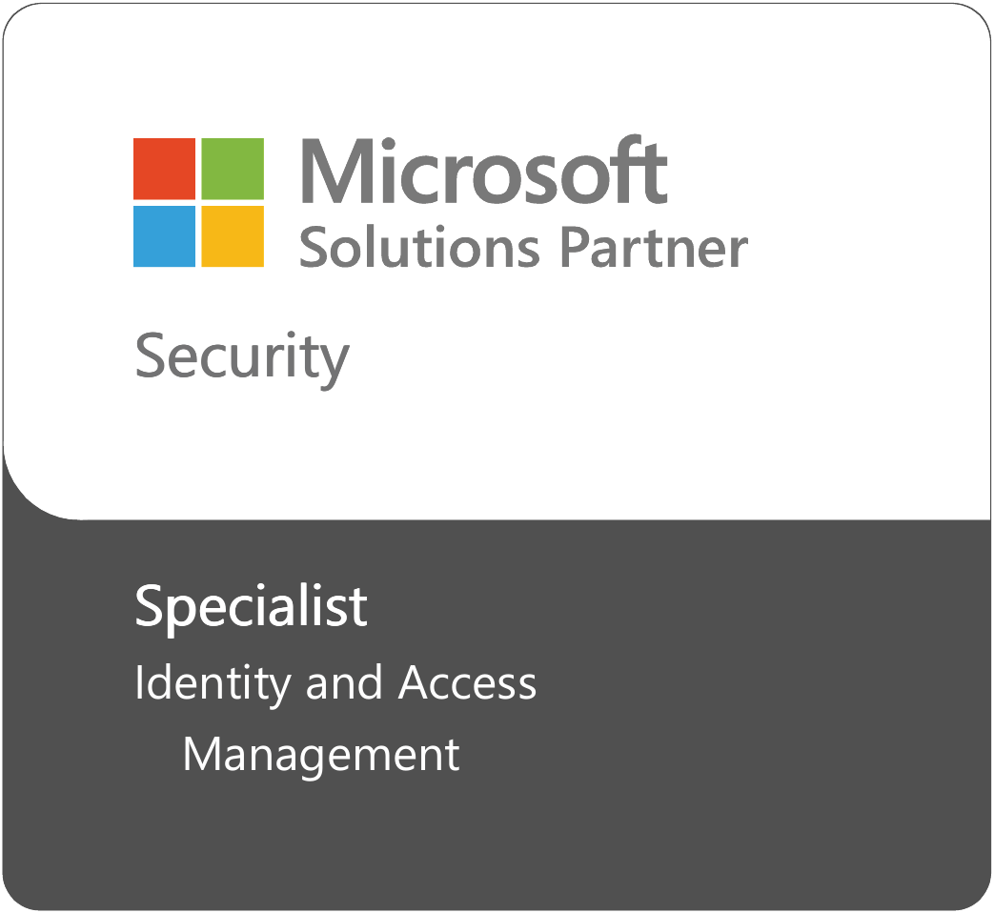

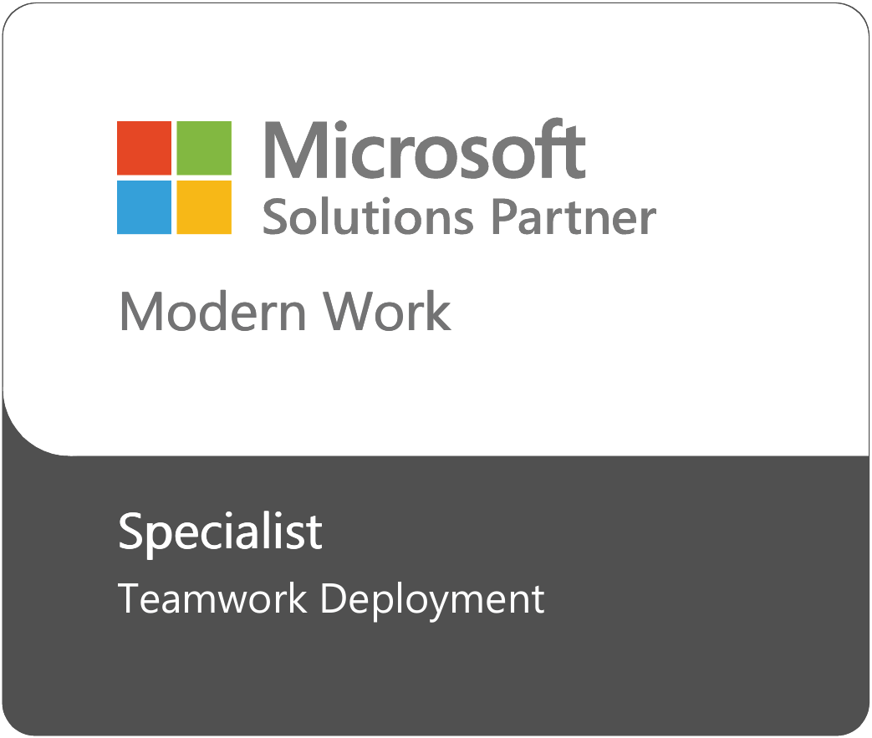
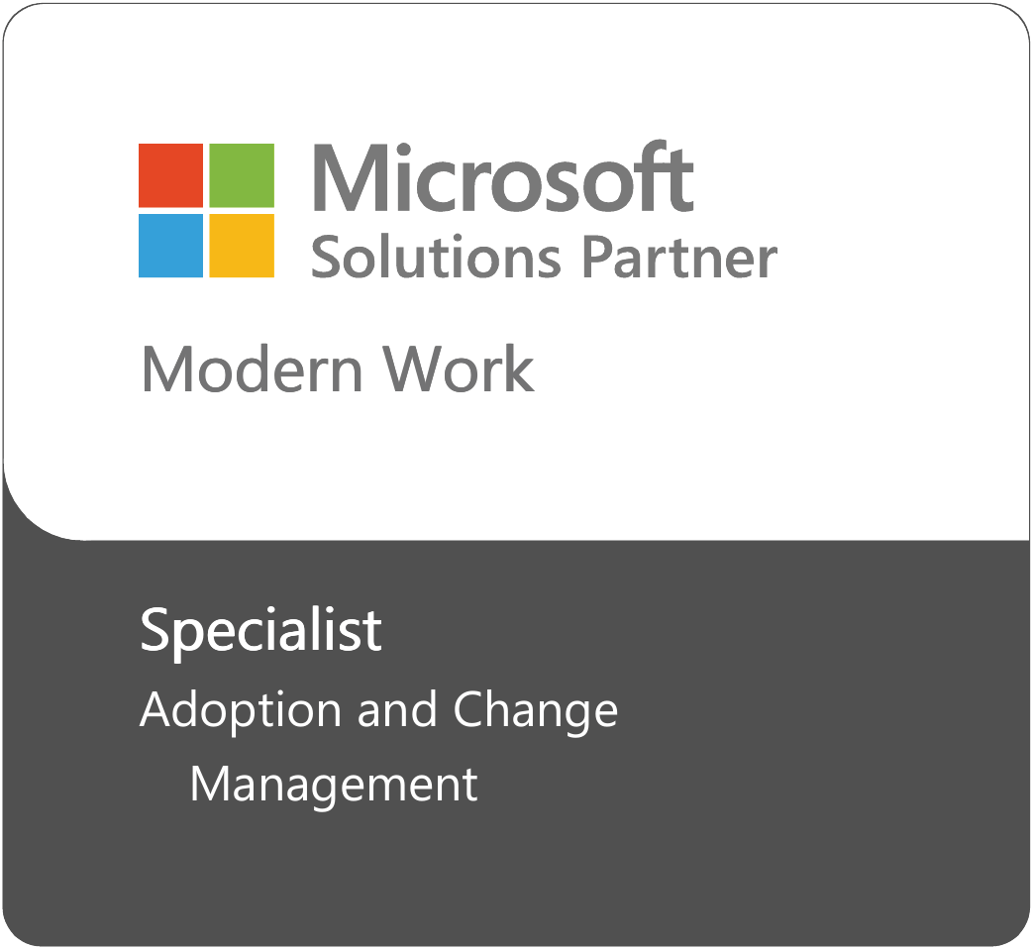


AT A GLANCE BESPIN GLOBAL & MICROSOFT
GEOGRAPHIC COVERAGE
ACCREDITATIONS
QATAR
150+
Technical Certifications Obtained
Microsoft Azure + Modern Workplace
LSP Partner (UAE)
CSP (Direct & Indirect) (UAE & KSA)
Fast-track Ready Partner
M365 Copilot JumpStart Ready Partner
BESPIN GLOBAL MEA
MICROSOFT VALUE
SEGMENT FOCUS
Enterprise
Public Sector
PROPOSITION
SMC
SMB
BESPIN GLOBAL SPECIALIZATIONS IN PROGRESS
Teamwork Deployment | Modernize Endpoint | Migrate Enterprise Applications
BG MARKETPLACE OFFERS
₁ Co-Sell Offer (Microsoft Copilot Offer)
+
5
Consultation Offers (Azure Services & MSP)

Slide 4
GET READY TO ACHIEVE MORE
with Bespin Global & M365 Copilot

Slide 5
COPILOT PRODUCTIVITY
Why is Microsoft 365 Copilot important to you
64%
of people struggle with having the time and energy to do their job
62%
spend too much time searching for information during the workday
60%
of leaders say a lack of innovation or breakthrough ideas is a concern

Slide 6
UNLOCKING AI POTENTIAL
Bespin Global & Microsoft‘s Best Practices for AI Adoption
AI Advisory
Deploying M365
Get Ready for M365 Copilot
Adoption & Change Management
Extending M365 Copilot
Help customers build
AI transformation strategies
Identify top personas and processes that would deliver value if reimagined with AI
Assess customer licensing and technical readiness and address gaps
Assess customers’ data protection and governance posture and address gaps
Deliver end-user readiness to enable proficient use of Copilot
Drive change management programs to transition processes and adapt behaviors
Expose data from LoB systems to enable access by Copilot
Build LoB plugins to enable customer-specific scenarios

Slide 7

















UNLOCK THE POTENTIAL
Technical Aspects
BUSINESS ASPECTS
TECHNICAL ASPECTS
AI
Unlock organization productivity and unleash new innovative solutions
Accelerate AI adoption with peace of mind through Bespin Copilot service offering
Streamline user interactions, enabling users to interact with apps through natural language
Boost productivity in communication, enhancing the overall collaborative experience
Boost your M365 investments & ROI in 4-12 weeks of engagement
Deliver an AI-driven experience to both employees and end clients
Improve document and content creation, by generating contents, summarizing materials and optimizing layout
Enhance data analysis, by automating the analysis, suggesting formulas and creating a visualization based on user queries

Slide 8
MICROSOFT 365 COPILOT JOURNEY
End-User Enablement & Adoption
Develop & Deliver Tailored Programs as per agreed use cases.
Review Adoption Data Analysis Report
Other enablement collaterals (User Guides, Online Videos, Adoption reports, etc.)
WHY CHOOSE BESPIN GLOBAL?
Rollout
Tenant Preparation, Modify Data Structures, Permissions, Identity & Access Policies
Address Security Vulnerabilities or compliance issues highlighted in the Readiness Assessment Report
Test Use Cases & User Experience with Limited Users (UAT) and sign-off. Go Live with all users/functions
Jumpstart Partner
Bespin Global is an Authorized Partner for “Copilot for Microsoft 365 Workshop”
Jumpstart Community Benefits
Seamless Experience & Onboarding
Dedicated live demo tenant for client hands-on experience.
Joint assessment with “Cloud for Works”
Assessment & Readiness
Identify Business Requirements
Create a Tailored M365 Copilot Strategy
Economic Benefits of M365 Copilot (ROI)
Implementation Plan

Slide 9






OFFERING
Key Deliverables
Standard
Pro
Elite
No of copilot users | 51 ~ 300 | 300 ~ 1000 | > 1000
Use case Identification workshop. | 1 | 3 | 3
Copilot Strategy | Yes | Yes | Yes
Economic Impact Calculator and ROI Calculations | Yes | Yes | Yes
Technical Assessment | Yes | Yes | Yes
M365 Copilot Deployment/Rollout | Yes | Yes | Yes
Staff Communication Emails | 5 | 5 | 5
Executives Online Workshops | 2 | 2 | 2
End-user Online Workshops | 5 (4-5 use case/workshop) | 10 (4-5 use case/workshop) | 15 (4-5 use case/workshop)
Videos | 2 Pre-recorded videos session | 2 Tailor-made walk- through videos | 2 Tailor-made walk- through videos
User Guides |  | 2 | 2
Adoption Data Analysis Report |  | 1 | 1
Champion Program | 1
Duration (Ph1, 2 & 3) | 4 Weeks (1+1+2) | 7-8 Weeks (2+2+3) | 16 Weeks (4+4+8)
Phase 1
Phase 2
Phase 3

Slide 10


BESPIN COPILOT ASSESSMENT
Build a tailored Copilot Strategy
PHASE 01
Assessment & Readiness
Assess your organizations needs & and goals
Identify business use cases from each department
Present the economic benefits (ROI) to customer
Copilot Readiness Assessment Report

Slide 11


COPILOT ADOPTION: WHY ASSESSMENT IS CRUCIAL?
Future-Proofing Your AI Adoption
Microsoft 365 Copilot Foundational Principals
+ +
+
AI
Security
Compliance
Privacy
Responsible AI
Guided by a
Core set of Principals
Fairness
Reliability & Safety
Privacy & Security
Inclusiveness
Transparency
Accountability
BG ASSESSMENT
Permissions model to Protect Data at all levels of the organization
Tenant
Group
Individual

Slide 12



BESPIN COPILOT ASSESSMENT
Tenant preparation
Copilot licenses activation (UAT Users)
Modify data structure, permissions, Identify & Access policies
PHASE 02
Deployment & Rollout
Pilot Deployment in a controlled environment
Test Use cases & User experience, Sign-off
Address security gaps as per Copilot suggestion in Readiness Report Go live with all copilot users & establish systems for monitoring

Slide 13





BESPIN COPILOT ASSESSMENT
Staff Communication emails
Executive online workshops End-user online workshops
PHASE 03
End User Enablement
& Adoption
Pre-recorded training videos
Champion program
Adoption data analysis report
User Guides
Walk through videos

Slide 14
PRICING
PRICE
STANDARD
PRO
ELITE
Copilot Assessment Service: Phase-1 | $14,400 | $14,400 | $14,400
Copilot Assessment Service: Phase-2 & 3 Rollout, End user enablement & Adoption | $26,000 $18,500 | $49,200 $41,700 | $68,600 $60,100
Standalone Phase-1 copilot assessment can be procured
In case client is willing to procure Phase-2 & 3, then it is mandatory to procure phase-1 assessment as well
Payment Term: Due on receipt
Subject to Clients eligibility for Copilot adoption accelerator fund $7,500
We’ll re-evaluate the feasibility of doing phase 3 in-house after successful 3-2 delivery of copilot with Cloud for Works starting with the Basic offer, and then for higher offers.

Slide 15
THANK YOU
Helping you Adopt Cloud

Slide 16
WHAT IS MICROSOFT 365 COPILOT
Introduction
Microsoft 365 Copilot is your AI-driven partner that combines the power of : Large language models (LLMs) with
Your data in the Microsoft Graph and The Microsoft 365 apps
Unleash Creativity
Harness Copilot’s power so you never start from scratch
Unlock Productivity
Copilot summarize actions for you, and optimize your time
Uplevel Skills
Be better at what you’re good at and master what you’ve yet to learn

Slide 17
WHY IS MICROSOFT 365 COPILOT IMPORTANT TO YOU
Introduction
64%
of people struggle with having the time and energy to do their job
62%
spend too much time searching for information during the workday
60%
of leaders say a lack of innovation or breakthrough ideas is a concern

Slide 18
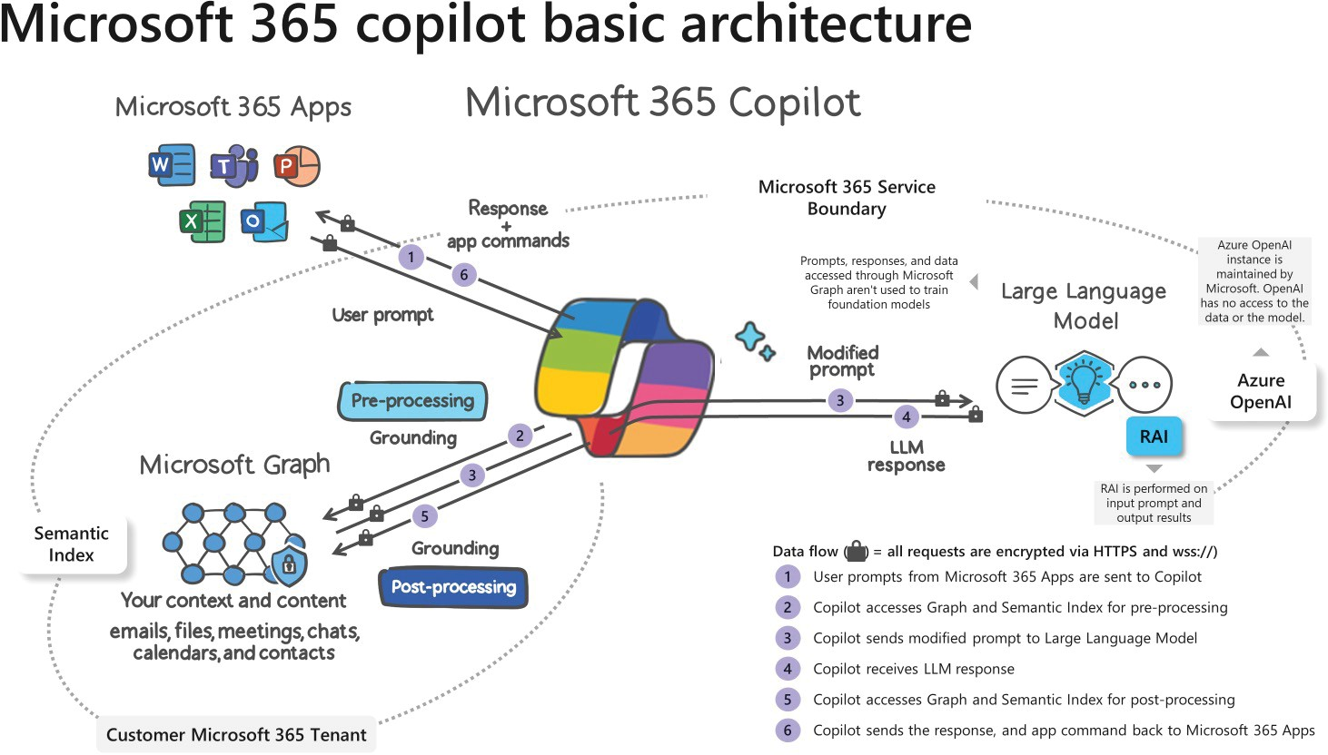
HOW DOES MICROSOFT 365 COPILOT WORK FOR YOU
Introduction
Prompts serve as commands for Microsoft 365 Copilot, directing it to create, summarize, edit, or transform content.

Slide 19





CHALLENGE IN MICROSOFT 365 COPILOT DEPLOYMENTS
Challenge
Product Launch
Usage Rates %
Unmanaged Users Adoption
Early Adopters Users
Adoption suffers
Deployment
Time

Slide 20
THE MAIN REASON BEHIND POOR ADOPTION OF MICROSOFT 365 COPILOT
Reason
MISSING THE DESIRE TO
LACK OF
RECOGNITION
LACK OF
AWARENESS
LACK OF
KNOWLEDGE
CHANGE
Users don’t know that the solutions exist and why they need to adopt the new technologies
Users don’t know what’s in it for them and are not committed to adopt the new technologies
Users don’t know how to use the new technologies and apply them in their day-to-day tasks
Adopters are not recognized and there is no system in place to monitor and reward progress

Slide 21
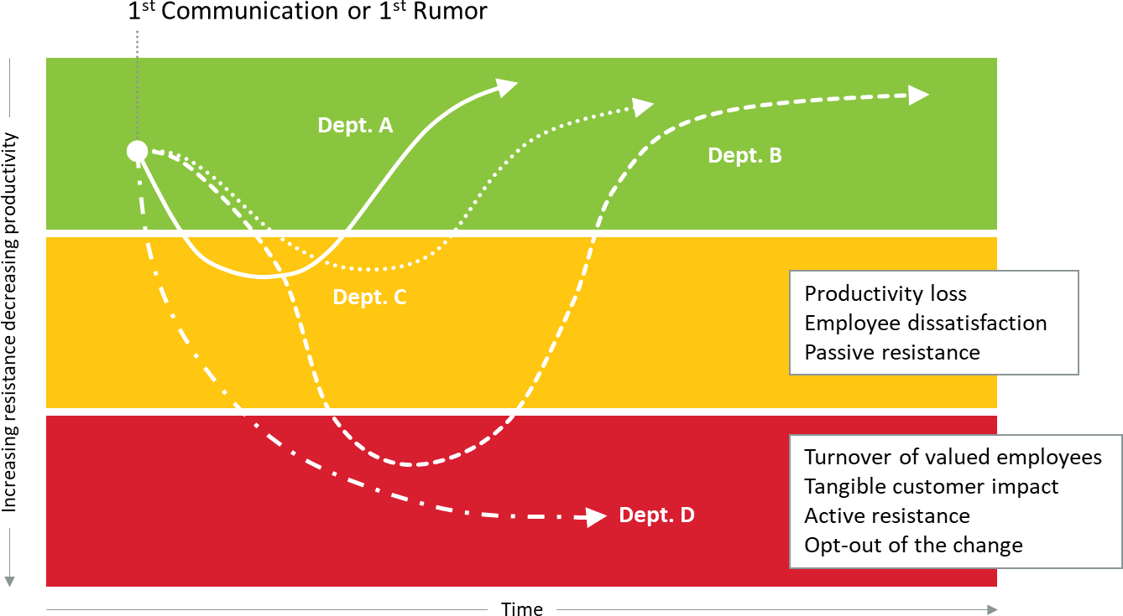
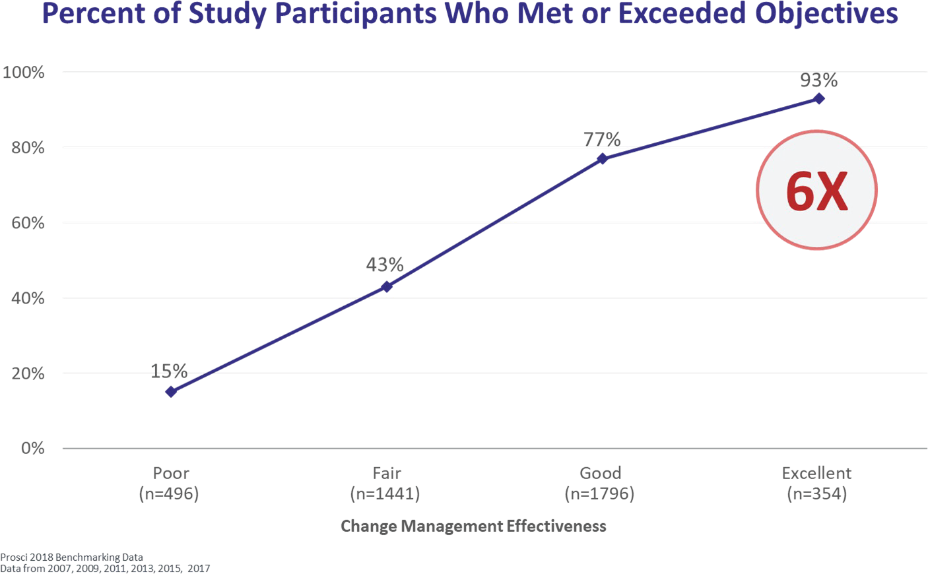
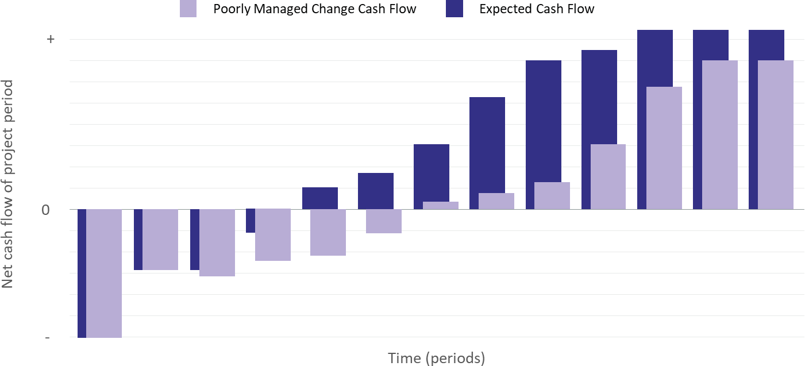
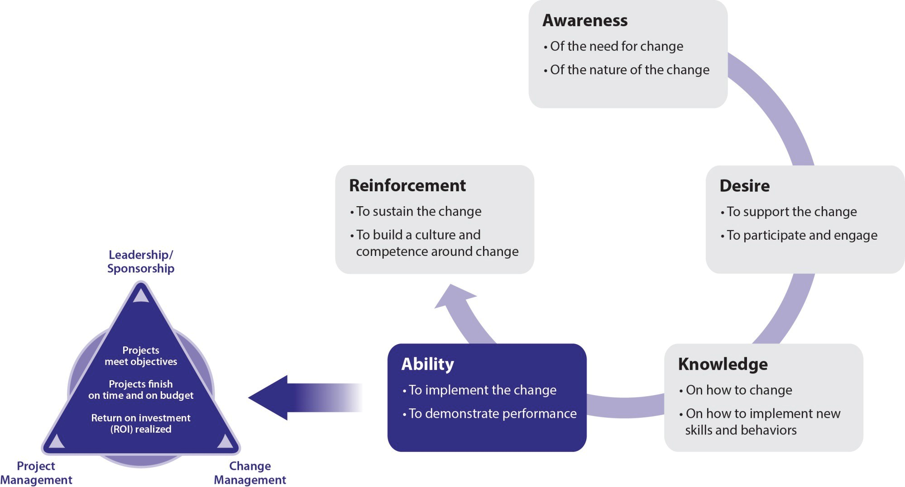
THINK CHANGE MANAGEMENT
The Solution
The Change impact will happen. Better to manage it.
6x Higher Chances of meeting the project Objectives
Better ROI
ADKAR: Proven Methodolgy

Slide 22

PROSCI® ADKAR® MODEL
We Recommended

Slide 23






ADVISORY BASED
Adoption
ASSESSMENT & PLANNING
Understand organization Strategic Objectives (Business Goals, User Challenges, .....)
Review Current Usage using reports Identify Gaps
Set Goals
A D
K A
R
AWARENESS ACTIVITIES
DISCOVERY WORKSHOPS
KNOWLEDGE TRANSFER
ABILITY TO USE
REINFORCEMENT ACTIVITIES
Generate content: Email, Videos, etc.
Identify business scenarios, what is in it for me, etc.
Generate how-to guides, create online courses, etc.
Conduct focused workshops, run a Champions Program, etc.
Analyze Data, Conduct Refreshers, Gamify Activity, etc.

Slide 24
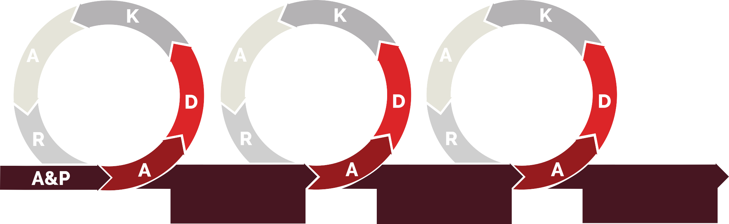
AS-A-SERVICE
Adoption
ASSESSMENT & PLANNING
Understand organization Strategic Objectives (Business Goals, User Challenges, .....)
Review Current Usage using reports Identify Gaps
Set Goals
A D
+ Monthly/weekly Advisory-based
Adoption Activities
+ Monthly/weekly Advisory-based
Adoption Activities
+ Monthly/weekly Advisory-based Adoption Activities
K A
R
AWARENESS ACTIVITIES
DISCOVERY WORKSHOPS
KNOWLEDGE TRANSFER
ABILITY TO USE
REINFORCEMENT ACTIVITIES
Generate content: Email, Videos, etc.
Identify business scenarios, what is in it for me, etc.
Generate how-to guides, create online courses, etc.
Conduct focused workshops, run a Champions Program, etc.
Analyze Data, Conduct Refreshers, Gamify Activity, etc.

Slide 25
ONBOARDING JOUNEY§
Sales Cycle
MICROSOFT 365
DETAILED ASSESSMENT
Sign Order
The client signs a formal assessment offer
Opp Closure
Client nomination for Jumpstart Workshop
Project Kick-off
Project team onboarding & Kick-off Discuss delivery plan & execution
Delivery
Copilot Assessment Delivery (Assessment, Rollout & Adoption)
Project Closure Client Feedback Sign-off
Project closure
COPILOT WORKSHOP
Opp Qualification
Check the eligibility Criteria for the Copilot Workshop Define Use Cases for the Demo & Workshop
Request Registration
Client nomination for Jumpstart Workshop
Request Approval
Client confirmation Internal onboarding
Opp. Closure
Client Onboarding Delivery Kick-off
Workshop Delivery
Conduct the workshop
Copilot Presentation
Demonstrate Use Cases on Bespin Demo Tenant

